Slide 1

RASD&DD project
Best Bike Paths
COMPUTER SCIENCE AND ENGINEERING
SOFTWARE ENGINEERING II
2025 – 2026
Authors: Guglielmi Leonardo, Lo Conte Francesco

Slide 2
RASD

Slide 3
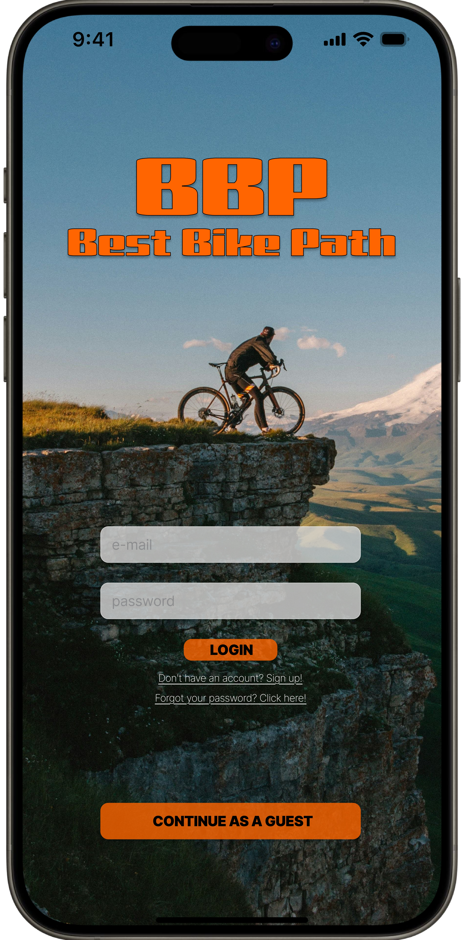
Goals
G1: Personal Tracking
G2: Community Crowdsourcing
G3: Quality-Based Routing
G4: Centralized Inventory
1

Slide 4
World vs Machine Phenomena
Shared (the boundary)
Machine
Alghoritms & Logic
Database
World
WP13 - Physical Sensors
WP16 - Road Conditions
WP14 - External Weather
SP_WC16 - Sensor Data
SP_WC10 - Map Paths
SP_MC5: Path Visualization
2

Slide 5
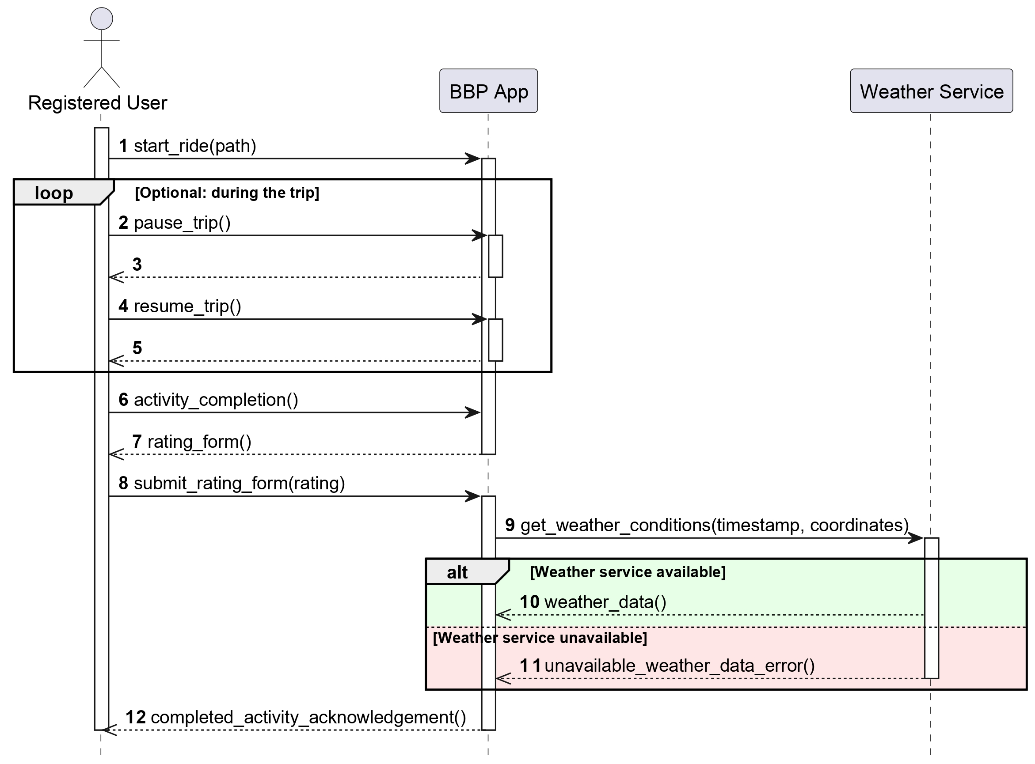
Core Use Case
3

Slide 6
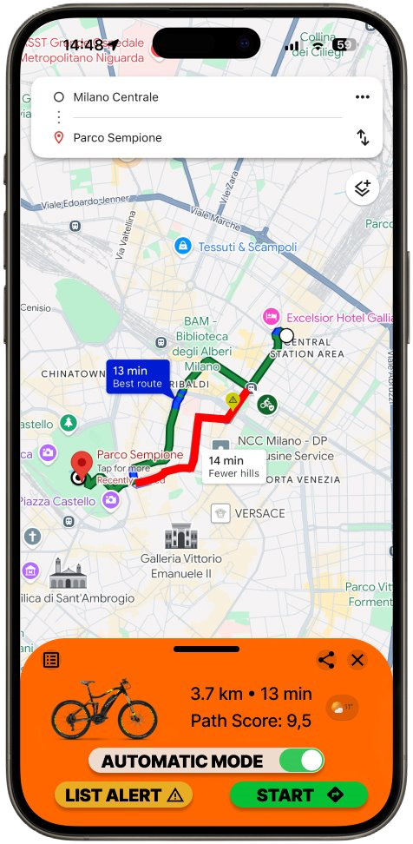
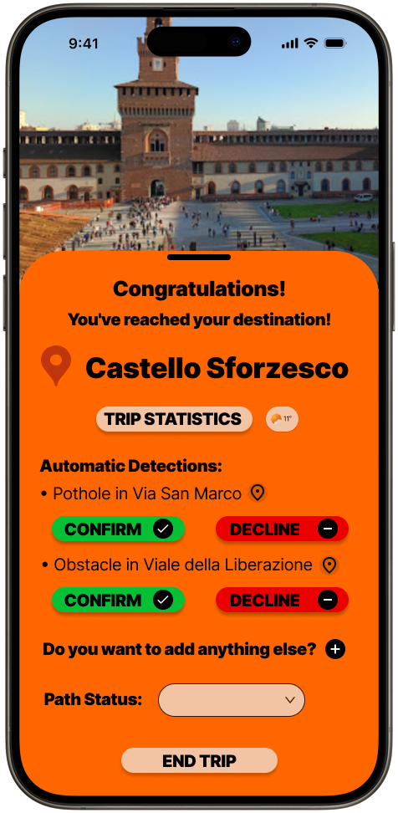
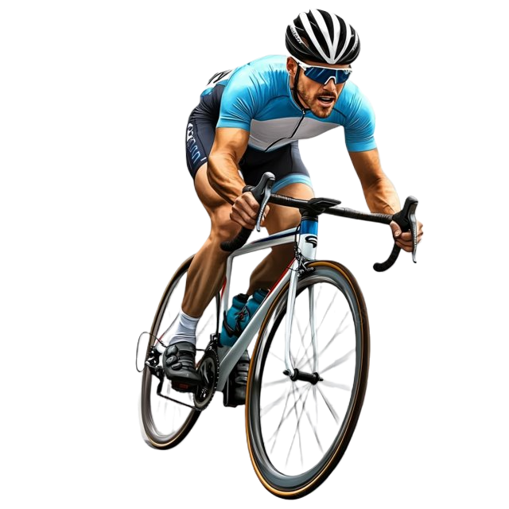
Core Use Case
4

Slide 7
Domain assumption & Requirements
Critical domain assumption
Most relevant requirements
D1 & D6
Calibrated sensors
Cycling patterns
D3
Truthful reports
R14 & R16
Hybrid Detection
Avoid false positives
R19 & R20
Dynamic Safety Scoring
Raw reports
Markers
5

Slide 8
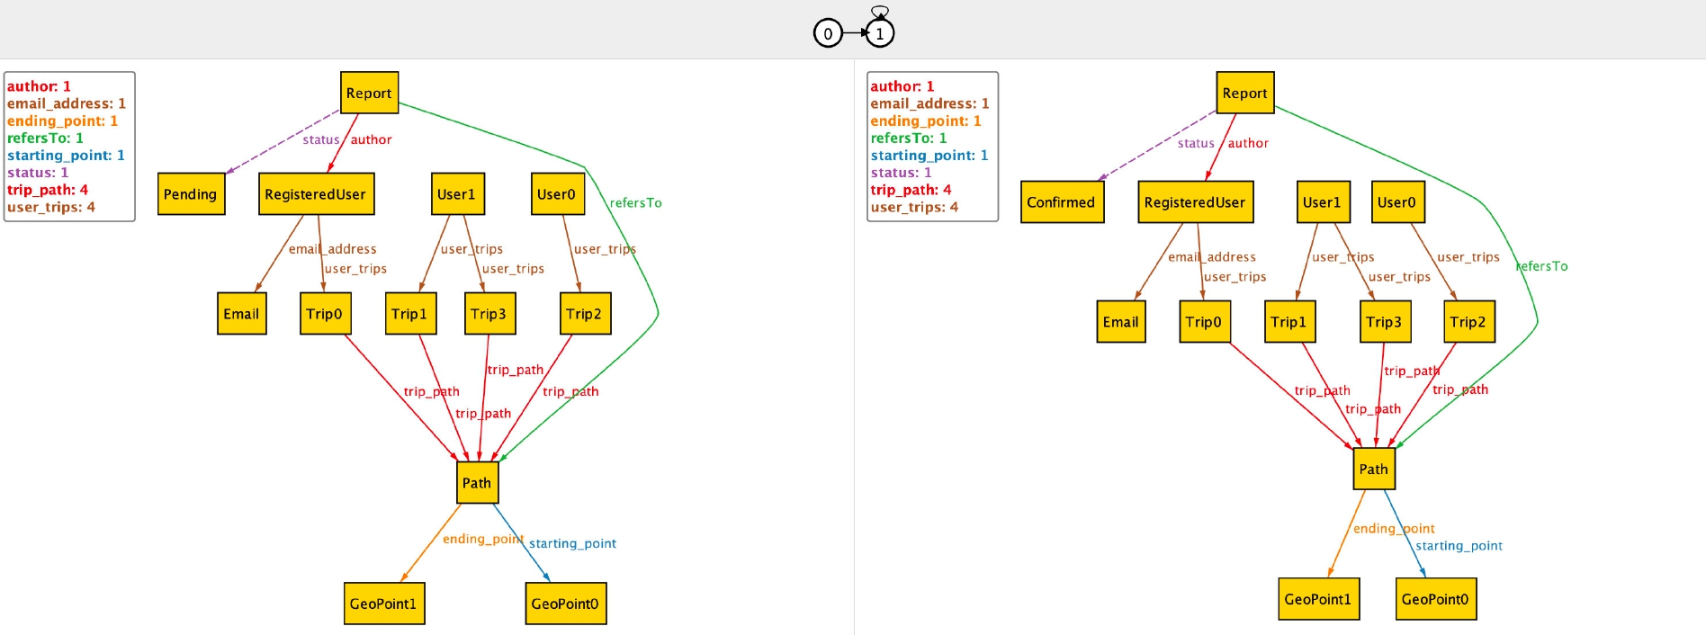
Alloy Model
6

Slide 9
DD

Slide 10
Architectural overview
Main architectural choices
Other choices
4-layer architecture
Presentation layer
“Fat” front-end application layer
Back-end application layer
Data layer
Microservices for the back-end
Horizontal scalability
Dynamic scalability
Differentiated tech-stack
API Gateway Pattern
Service Proxy Pattern
Circuit Breaker Pattern
Differentiated database management
Server-side load balancing
Server-side service discovery
7

Slide 11
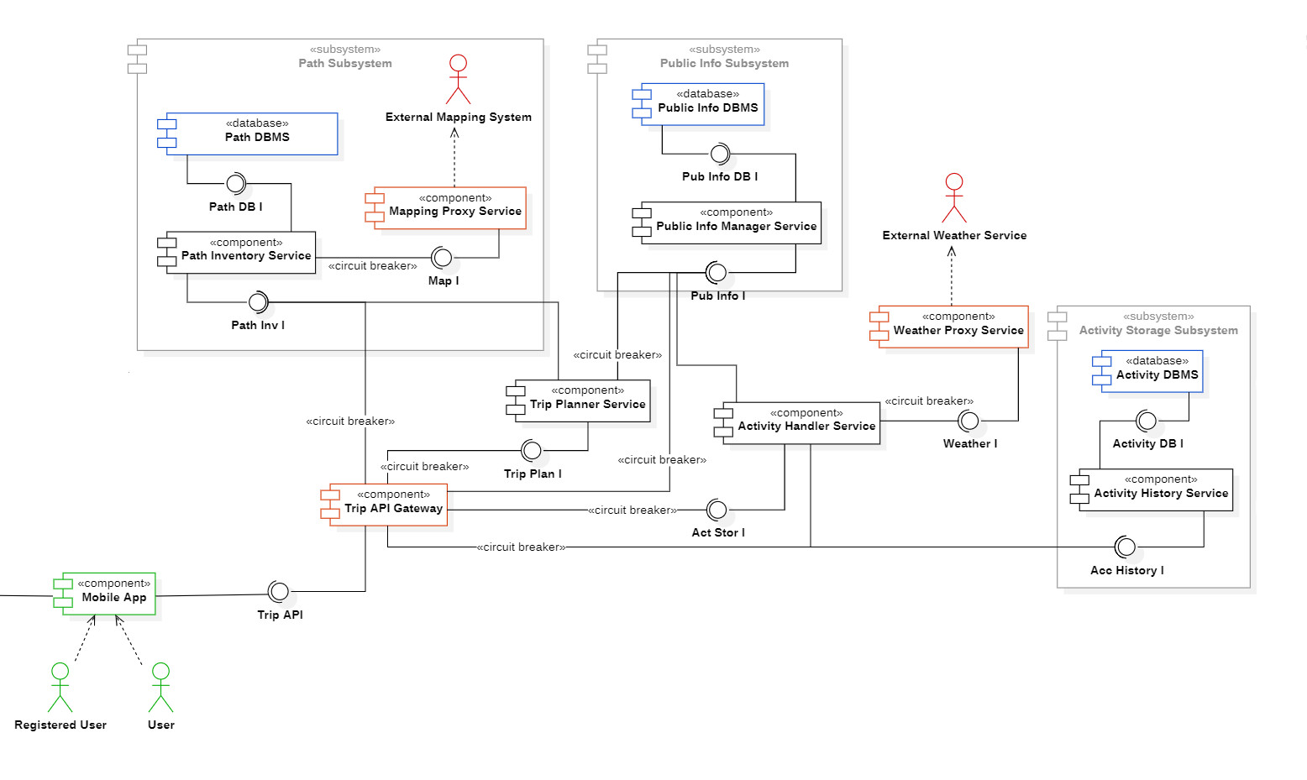
Component diagram
Critical components
Trip API Gateway
Trip Planner Service
Activity Handler Service
Path Subsystem
Activity Storage Subsystem
8

Slide 12
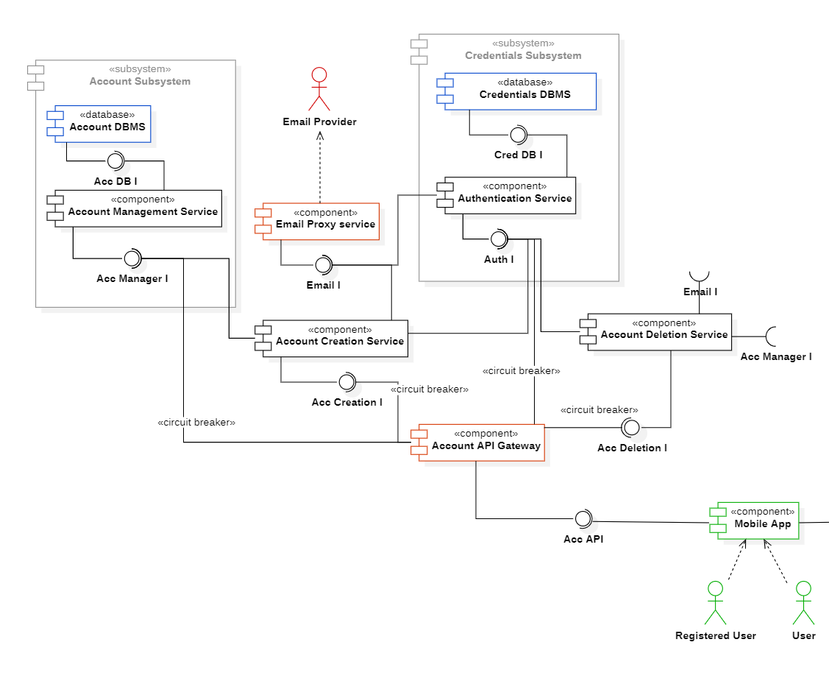
Component diagram
Critical components
Account API Gateway
Authentication Subsystem
Account Management Subsystem
9

Slide 13
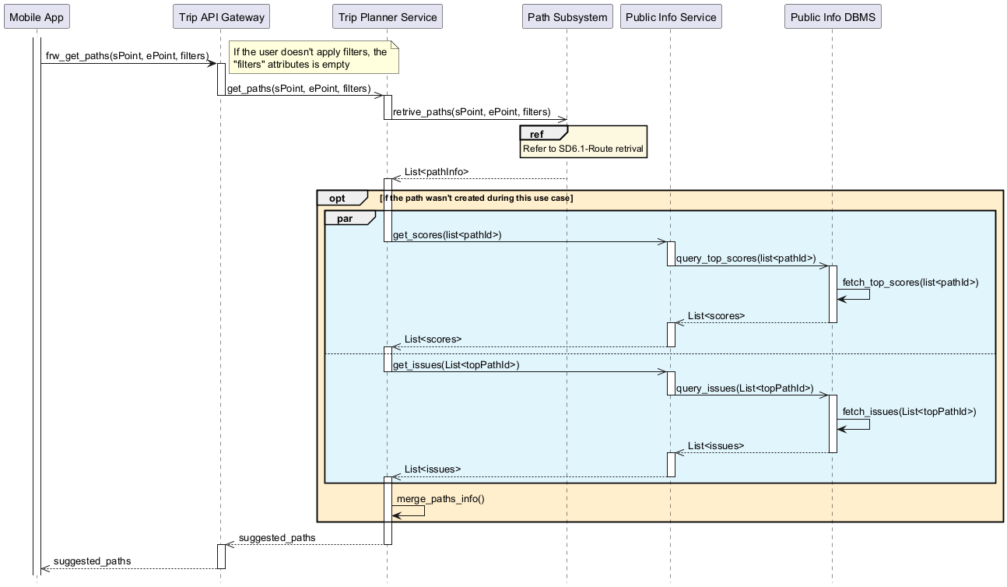
Interactions between components: meaningful case
10

Slide 14
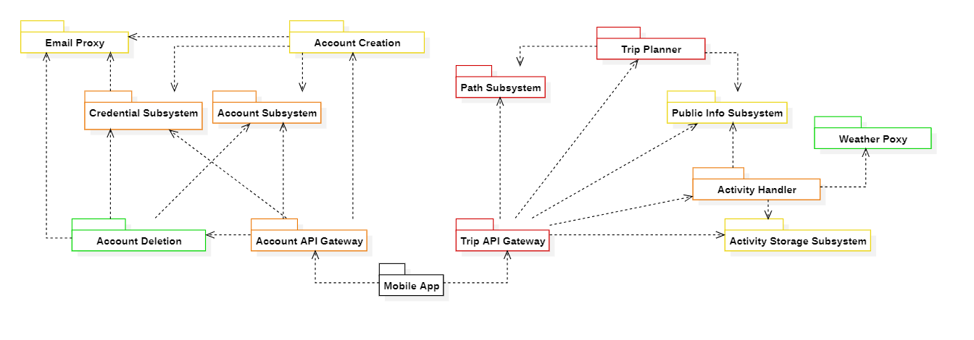
Integration and Validation plan
Hybrid integration plan
Bottom-up strategy for subsystems integration
Risk-driven integration for macro-components integration
11

Slide 15
Thanks for the attention!

Slide 16

COMPUTER SCIENCE AND ENGINEERING
SOFTWARE ENGINEERING II
2025 - 2026
Best Bike Paths
Authors: Guglielmi Leonardo, Lo Conte Francesco

Slide 17
Best Bike Paths
Template slide normale
Authors: Guglielmi Leonardo, Lo Conte Francesco

Slide 18
Title
#

